Slide 1
Advanced Computer Networks (CS6302)
Dr. Judhistir Mahapatro
Department of Computer Science and Engineering National Institute of Technology Rourkela

Slide 2
Wireless LANs

Slide 3
IEEE 802 ARCHITECTURE
standardized protocol architecture for LANs, which encompasses physical, medium access control, and logical link control layers
In OSI terms, higher-layer protocols (layer 3 or 4 and above) are independent of network architecture and are applicable to LANs, MANs, and WANs
The IEEE 802 architecture
has been adopted by all organizations working on the specification of LAN
standards. It is generally referred to as the IEEE 802 reference model.

Slide 4
IEEE 802 ARCHITECTURE
the lowest layer of the IEEE 802 reference model corresponds to the physical layer of the OSI model and includes such functions as
Encoding/decoding of signals (e.g., PSK, QAM, etc.)
Preamble generation/removal (for synchronization)
Bit transmission or reception
In addition, the physical layer of the 802 model includes a specification of the transmission medium and the topology
Generally, this is considered "below" the lowest layer of the OSI model

Slide 5
IEEE 802 ARCHITECTURE
For some of the IEEE 802 standards, the physical layer is further subdivided into sublayers
Physical layer convergence procedure (PLCP): Defines a method of mapping 802.11 MAC layer protocol data units (MPDUs) into a framing format suitable for sending and receiving user data and management information between two or more stations using the associated PMD sublayer.
Physical medium dependent sublayer (PMD): Defines the characteristics of, and method of transmitting and receiving, user data through a wireless medium between two or more stations

Slide 6
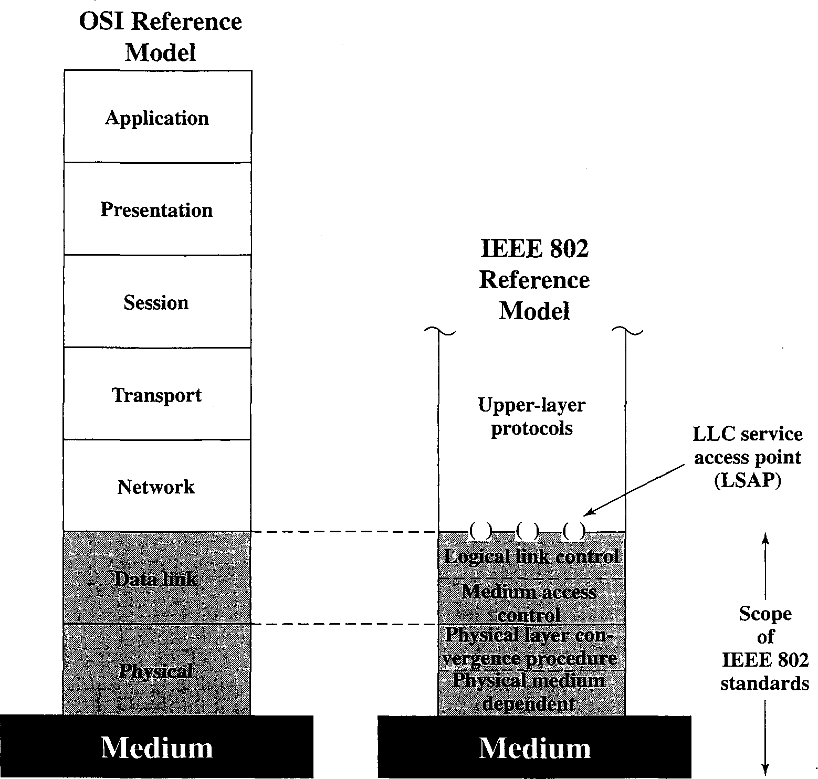
IEEE 802 ARCHITECTURE

Slide 7
IEEE 802 ARCHITECTURE
Above the physical layer are the functions associated with providing service to LAN users. These include
On transmission, assemble data into a frame with address and error detection fields.
On reception, disassemble frame, and perform address recognition and error detection.
Govern access to the LAN transmission medium.
Provide an interface to higher layers and perform flow and error control
MAC
LLC

Slide 8
IEEE 802 ARCHITECTURE
The separation in layer2 is done for the following reasons:
The logic required to manage access to a shared- access medium is not found in traditional layer 2 data link control.
For the same LLC, several MAC options may be provided.

Slide 9
IEEE 802 ARCHITECTURE
Higher-level data are passed down to LLC, which appends control information as a header, creating an LLC protocol data unit (PDU).
This control information is used in the operation of the LLC protocol.
The entire LLC PDU is then passed down to the MAC layer, which appends control information at the front and back of the packet, forming a MAC frame.
the control information in the frame is needed for the operation of the MAC protocol.

Slide 10
IEEE 802.11 ARCHITECTURE
IEEE has defined the specifications for a wireless LAN, called IEEE 802.11, which covers the physical and data link layers.
Basic Service Set
IEEE 802.11 defines the basic service set (BSS) as the building block of
a wireless LAN.
A basic service set is made of stationary or mobile wireless stations and an optional central base station, known as the access point (AP).
The BSS without an AP is a stand-alone network and cannot send data
to other BSSs.
It is called an ad hoc architecture. In this architecture, stations can form a network
without the need of an AP; they can locate one another and agree to
be part of a BSS.
A BSS with an AP is sometimes referred to as an infrastructure
network.

Slide 11
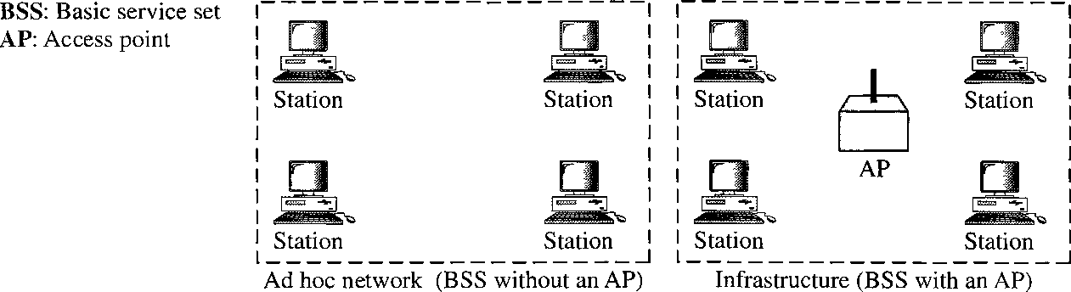
IEEE 802.11 ARCHITECTURE
Basic Service Set

Slide 12
IEEE 802.11 ARCHITECTURE
Extended Service Set
An extended service set (ESS) is made up of two or more BSSs with APs.
the BSSs are connected through a distribution system, which is usually a wired LAN. The distribution system connects the APs in the BSSs.
IEEE 802.11 does not restrict the distribution system; it can be
any IEEE LAN such as an Ethernet.
Note that the extended service set uses two types of stations: mobile and stationary.
The mobile stations are normal stations inside a BSS. The
stationary stations are AP stations that are part of a wired LAN.

Slide 13
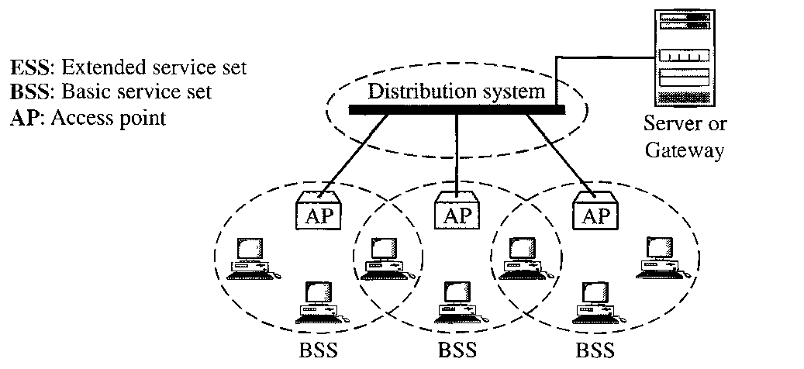
IEEE 802.11 ARCHITECTURE
Extended Service Set

Slide 14
IEEE 802.11 ARCHITECTURE
When BSSs are connected, the stations within reach of one another can communicate without the use of an AP.
communication between two stations in two different BSSs usually occurs via two APs.
The idea is similar to communication in a cellular network if we consider each BSS to be a cell and each AP to be a base station.
Note that a mobile station can belong to more than one BSS at the same time.

Slide 15
IEEE 802.11 ARCHITECTURE
Station Types
IEEE 802.11 defines three types of stations based on their mobility in a wireless LAN: no-transition, BSS-transition, and ESS-transition mobility.
A station with no-transition mobility is either stationary (not moving) or moving only inside a BSS.
A station with BSS-transition mobility can move from one BSS to another, but the movement is confined inside one ESS.
A station with ESS-transition mobility can move from one ESS to another. However, IEEE 802.11 does not guarantee that communication is continuous during the move.

Slide 16
IEEE 802.11 ARCHITECTURE
A station must maintain an association with the AP
Association:
Establishes an initial association with an AP before a station can transmit/receive frames on a wireless LAN, its identity and address must be known.
The AP can then communicate this information to other APs within the ESS to facilitate routing and delivery of frames.
Reassociation:
Enables an established association to be transferred from one AP to another, allowing a mobile station to move from one BSS to another.
Disassociation:
A notification from either a station or an AP that an existing association is terminated.
A station should give this notification before leaving an ESS or shutting down. However, the MAC management protects itself against stations that disappear without notification.

Slide 17
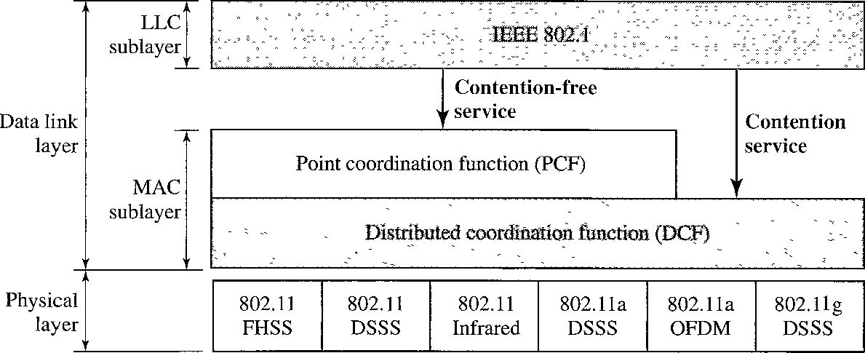
IEEE 802.11 ARCHITECTURE
MAC Sublayer
– IEEE 802.11 defines two MAC sublayers: the distributed coordination function (DCF) and point coordination function (PCF).

Slide 18
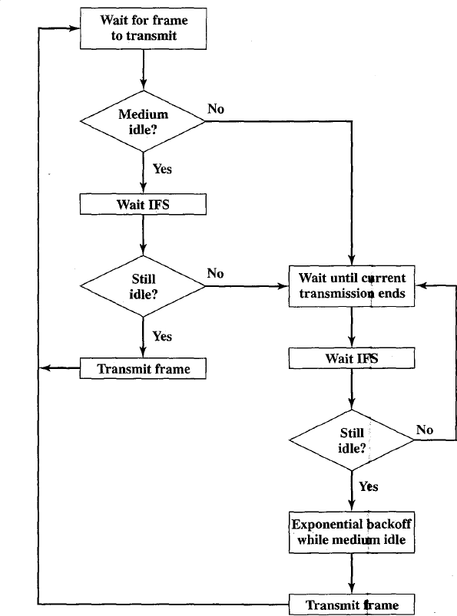
IEEE 802.11 Medium Access Control Logic

Slide 19
IEEE 802.11 ARCHITECTURE
Distributed Coordination Function
DCF uses CSMAICA as the access method. Wireless LANs cannot implement CSMAlCD for three reasons:
For collision detection a station must be able to send data and receive collision signals at the same time. This can mean costly stations and increased bandwidth requirements.
Collision may not be detected because of the hidden station problem.
The distance between stations can be great. Signal fading could prevent a station at one end from hearing a collision at the other end.

Slide 20
CSMAICA
Before sending a frame, the source station senses the medium by checking the energy level at the carrier frequency.
The channel uses a persistence strategy with back-off until the channel is idle.
After the station is found to be idle, the station waits for a period of time called the distributed interframe space (DIFS); then the station sends a the request to send (RTS).

Slide 21
CSMAICA
After receiving the RTS and waiting a period of time called the short interframe space (SIFS), the destination station sends a control frame, called the clear to send (CTS), to the source station.
This control frame indicates that the destination station is ready to receive data.

Slide 22
CSMAICA
The source station sends data after waiting an amount of time equal to SIFS.
The destination station, after waiting an amount of time equal to SIFS, sends an acknowledgment to show that the frame has been received.
Acknowledgment is needed in this protocol because the station does not have any means to check for the successful arrival of its data at the destination.
On the other hand, the lack of collision in CSMAlCD is a kind of indication to the source that data have arrived.

Slide 23
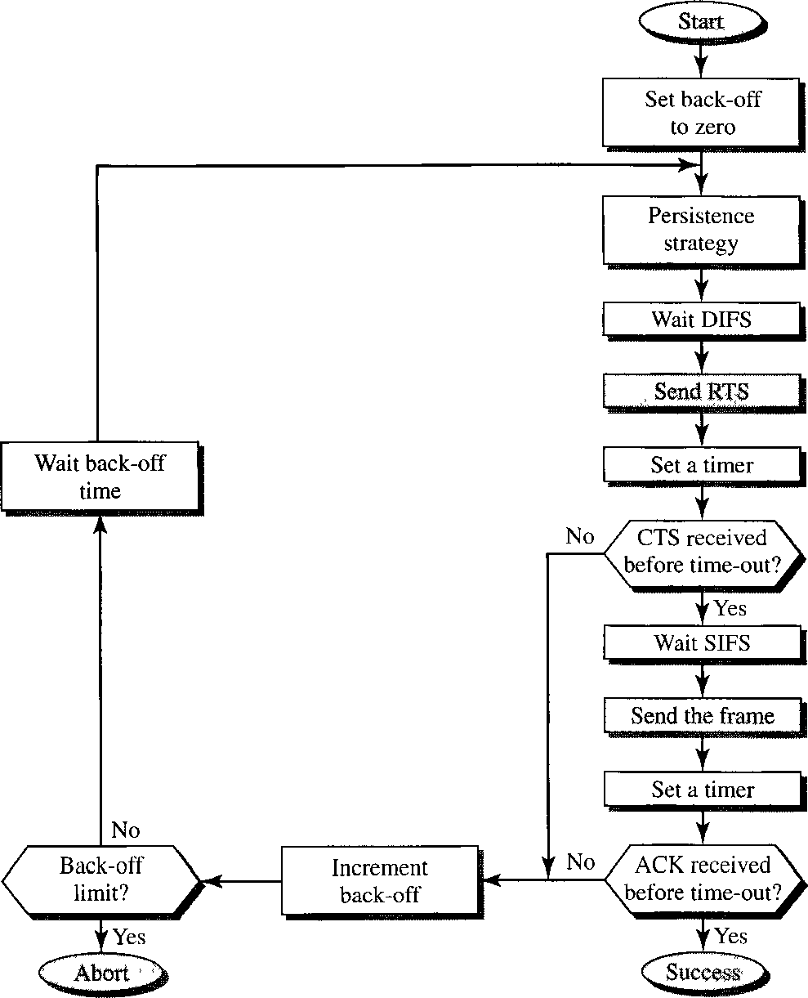
IEEE 802.11 ARCHITECTURE
CSMAICA

Slide 24
The Binary Exponential Backoff Algorithm
Procedure
After the first collision, each station waits either 0 or 1 slot times before trying again
After the second collision, each one picks either 0, 1, 2, or 3 at random and waits that number of slot times
– …
After the k^{th} collision, each station choose 0~2^{k}-1 slots, if k < 10
If k>=10, each station randomly choose 0~1023 slots to defer its transmission

Slide 25
Exchange of data and control messages
When a station sends an RTS frame, it includes the duration of time that it needs to occupy the channel.
The stations that are affected by this transmission create a timer called a network allocation vector (NAV) that shows how much time must pass before these stations are allowed to check the channel for idleness.
Each time a station accesses the system and sends an RTS frame, other stations start their NAV.
In other words, each station, before sensing the physical medium to see if it is idle, first checks its NAV to see if it has expired.

Slide 26
Cont…
Collision During Handshaking (when RTS or CTS control frames are in transition, often called the handshaking period?)
Two or more stations may try to send RTS frames at the same time. These control frames may collide.
Because there is no mechanism for collision detection, the sender assumes there has been a collision if it has not received a CTS frame from the receiver.
The back-off strategy is employed, and the sender tries again.

Slide 27
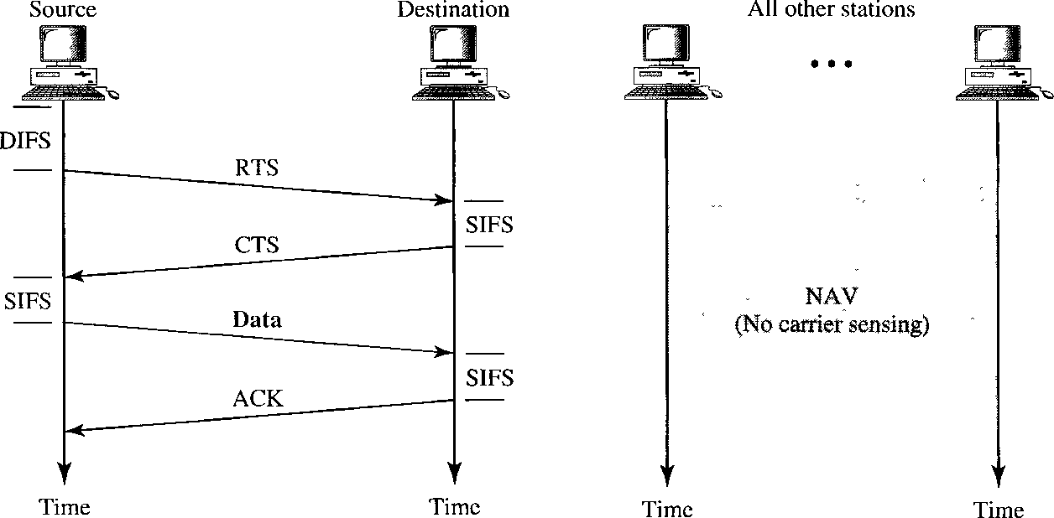
IEEE 802.11 ARCHITECTURE
Exchange of data and control messages

Slide 28
three values for IFS
SIFS (short IFS): The shortest IFS, used for all immediate response actions
PIFS (point coordination function IFS): A middlelength IFS, used by the centralized controller in the PCF scheme when issuing polls
DIFS (distributed coordination function IFS): The longest IFS, used as a minimum delay for asynchronous frames contending for access

Slide 29
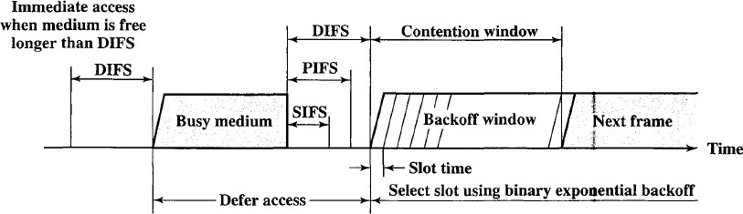
Access method

Slide 30
Point Coordination Function (PCF)
The point coordination function (PCF) is an optional access method that can be implemented in an infrastructure network (not in an ad hoc network).
It is implemented on top of the DCF and is used mostly for time-sensitive transmission and priority.

Slide 31
Point Coordination Function (PCF)
PCF has a centralized, contention-free polling access method.
The AP performs polling for stations that are capable of being polled.
The stations are polled one after another, sending any data they have to the AP.

Slide 32
Point Coordination Function (PCF)
To give priority to PCF over DCF, another set of interframe spaces has been defined: PIFS and SIFS.
The SIFS is the same as that in DCF, but the PIFS (PCF IFS) is shorter than the DIFS.
This means that if, at the same time, a station wants to use only DCF and an AP wants to use PCF, the AP has priority.

Slide 33
Point Coordination Function (PCF)
Due to the priority of PCF over DCF, stations that only use DCF may not gain access to the medium.
To prevent this, a repetition interval has been designed to cover both contention-free (PCF) and contention-based (DCF) traffic.
The repetition interval, which is repeated continuously, starts with a special control frame, called a beacon frame.
When the stations hear the beacon frame, they start their NAV for the duration of the contention-free period of the repetition interval.

Slide 34
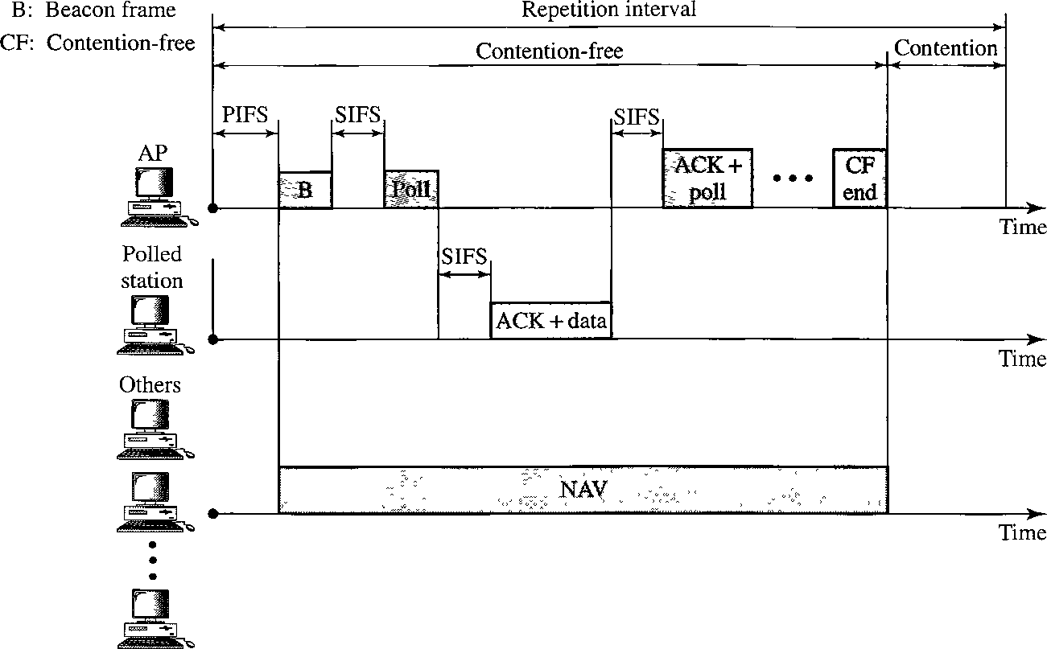

Slide 35
Fragmentation
The wireless environment is very noisy; a corrupt frame has to be retransmitted.
The protocol recommends fragmentation-the division of a large frame into smaller ones.
It is more efficient to resend a small frame than a large one.

Slide 36
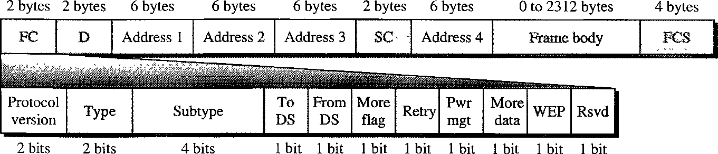
Frame Format
– Frame control (FC). The FC field is 2 bytes long and defines the type of frame and some control information.

Slide 37
Field | Explanation
Version | Current version is 0
Type | Type of information: management (00), control (01), data (10)
Subtype | Subtype of each type
To DS | Defined later
From DS | Defined later
More flag | When set to 1, means more fragments
Retry | When set to 1, means retransmitted frame
Pwr mgt | When set to 1, means station is in power management mode
More data | When set to 1, means station has more data to send
WEP | Wired Equivalent Privacy (encryption implemented)
Rsvd | Reserved

Slide 38
D. In all frame types except one, this field defines the duration of the transmission that is used to set the value of NAV. In one control frame, this field defines the ID of the frame.
Addresses. There are four address fields, each 6 bytes long. The meaning of each address field depends on the value of the To DS and From DS subfields.
Sequence control. This field defines the sequence number of the frame to be used in flow control.
Frame body. This field, which can be between 0 and 2312 bytes, contains information based on the type and the subtype defined in the FC field.
FCS. The FCS field is 4 bytes long and contains a CRC-32 error detection sequence.

Slide 39
Frame Types
A wireless LAN defined by IEEE 802.11 has three categories of frames: management frames, control frames, and data frames.
Management Frames: they are used for the initial communication between stations and access points.
Control Frames: they are used for accessing the channel and acknowledging frames.

Slide 40
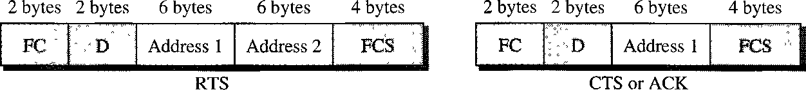
For control frames the value of the type field is 01; the values of the subtype fields for frames as follows.
Subtype | Meaning
1011 | Request to send (RTS)
1100 | Clear to send (CTS)
1101 | Acknowledgement (ACK)

Slide 41
Addressing Mechanism
The IEEE 802.11 addressing mechanism specifies four cases, defined by the value of the two flags in the FC field, To DS and From DS.
Each flag can be either 0 or I, resulting in four different situations.
The interpretation of the four addresses (address I to address 4) in the MAC frame depends on the value of these flags.

Slide 42
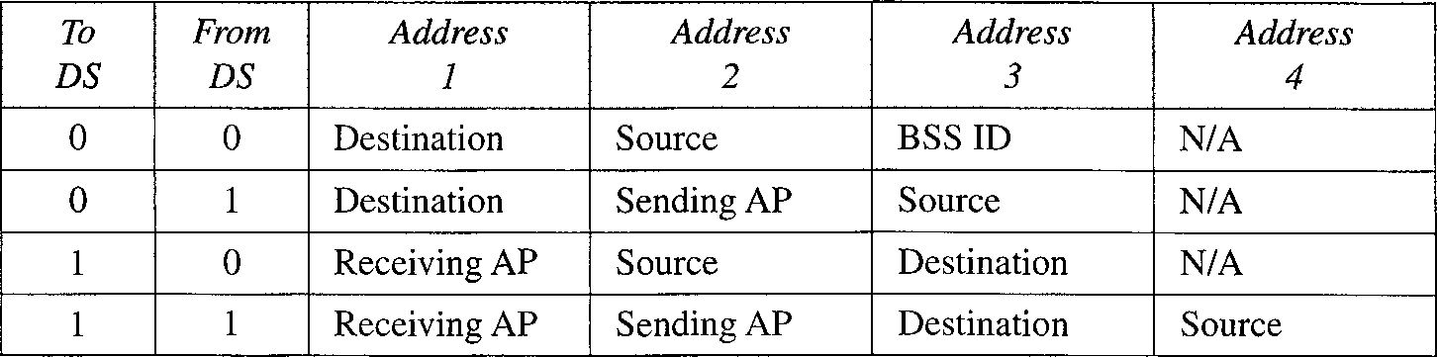
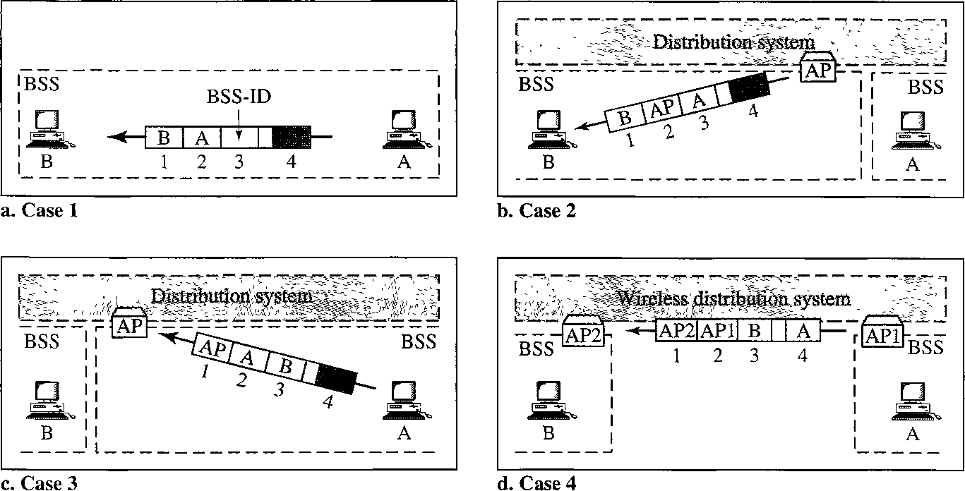

Slide 43
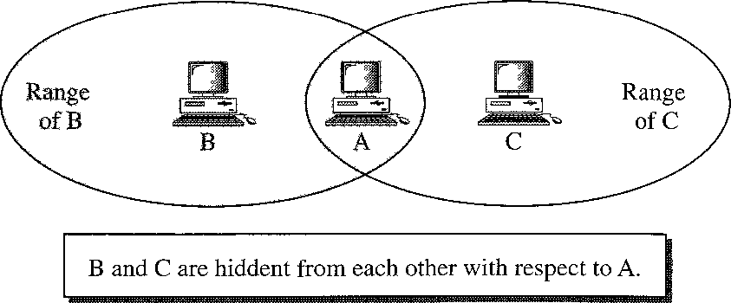
Hidden Station Problem

Slide 44
Hidden Station Problem
Assume that station B is sending data to station A.
In the middle of this transmission, station C also has data to send to station A. However, station C is out of B's range and transmissions from B cannot reach C. Therefore C thinks the medium is free.
Station C sends its data to A, which results in a collision at A because this station is receiving data from both B and C. In this case, we say that stations Band C are hidden from each other with respect to A.
Hidden stations can reduce the capacity of the network because of the possibility of collision.

Slide 45
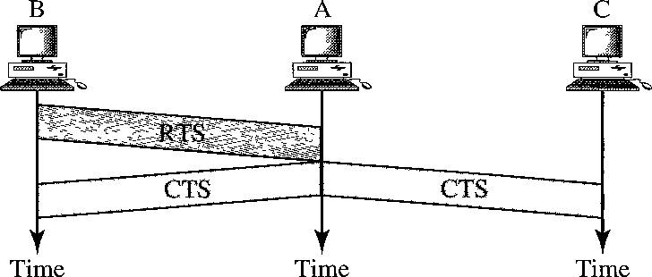
Hidden Station Problem
The CTS frame in CSMAICA handshake can prevent collision from a hidden station.

Slide 46
Exposed Station Problem
In this problem a station refrains from using a channel when it is, in fact, available.
Station A is transmitting to station B.
Station C has some data to send to station D, which can be sent without interfering with the transmission from A to B. However, station C is exposed to transmission from A; it hears what A is sending and thus refrains from sending.
In other words, C is too conservative and wastes the capacity of the channel.

Slide 47
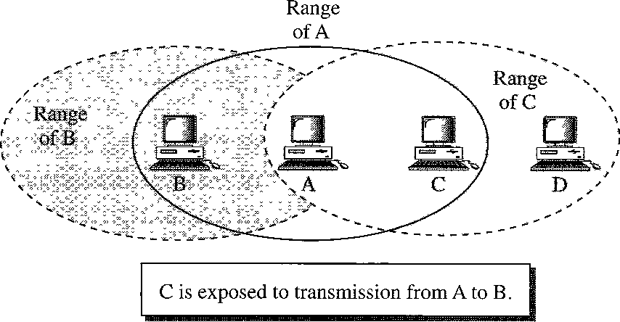
Exposed Station Problem

Slide 48
Use of handshaking in exposed station problem
Handshaking messages RTS and CTS cannot help in this case.
Station C hears the RTS from A, but does not hear the CTS from B. Station C, after hearing the RTS from A, can wait for a time so that the CTS from B reaches A; it then sends an RTS to D to show that it needs to communicate with D. Both stations B and A may hear this RTS, but station A is in the sending state, not the receiving state.
Station B, however, responds with a CTS. The problem is here. If station A has started sending its data, station C cannot hear the CTS from station D because of the collision; it cannot send its data to D. It remains exposed until A finishes sending its data

Slide 49
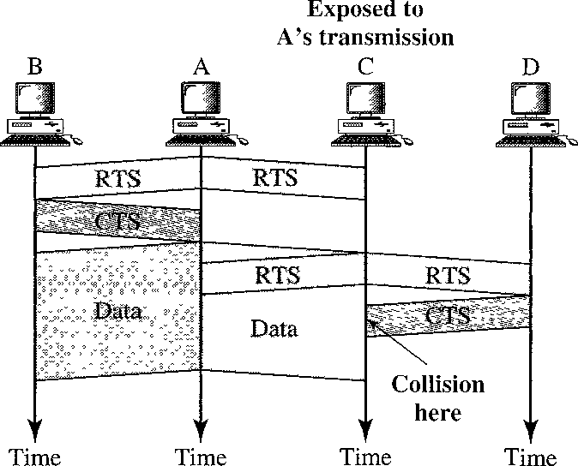
Use of handshaking in exposed station problem

Slide 50
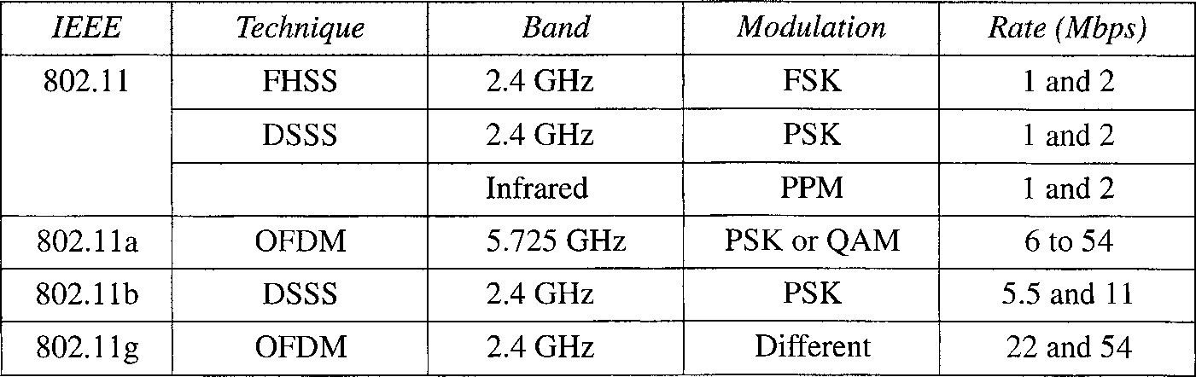
Physical Layer
All implementations, except the infrared, operate in the industrial, scientific, and medical (ISM) band, which defines three unlicensed bands in the three ranges 902- 928 MHz, 2.400—2.4835 GHz, and 5.725-5.850 GHz

Slide 51
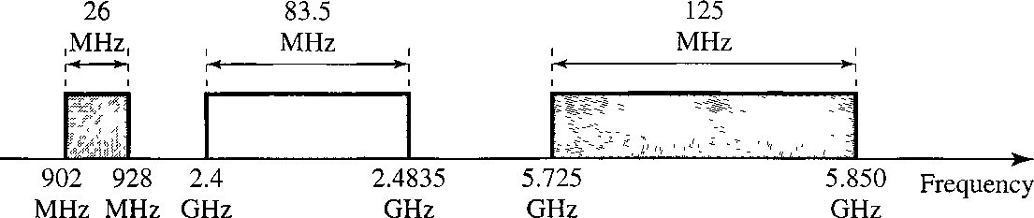
Physical Layer

Slide 52
IEEE 802.11 FHSS
IEEE 802.11 FHSS uses the frequency-hopping spread spectrum (FHSS) method
FHSS uses the 2.4-GHz ISM band.
The band is divided into 79 sub-bands of 1 MHz (and some guard bands). A pseudorandom number generator selects the hopping sequence.
The modulation technique in this specification is either two-level FSK or four-level FSK with 1 or 2 bits/baud, which results in a data rate of 1 or 2 Mbps

Slide 53
IEEE 802.11 DSSS
IEEE 802.11 DSSS uses the direct sequence spread spectrum (DSSS) method.
DSSS uses the 2.4-GHz ISM band.
The modulation technique in this specification is PSK at 1Mbaud/s. The system allows 1 or 2 bits/baud (BPSK or QPSK), which results in a data rate of 1 or 2 Mbps.

Slide 54
IEEE 802.11 Infrared
IEEE 802.11 infrared uses infrared light in the range of 800 to 950 nm. The modulation technique is called pulse position modulation (PPM).
For a 1-Mbps data rate, a 4-bit sequence is first mapped into a I6-bit sequence in which only one bit is set to 1 and the rest are set to 0.
For a 2-Mbps data rate, a 2-bit sequence is first mapped into a 4-bit sequence in which only one bit is set to 1 and the rest are set to 0.
The mapped sequences are then converted to optical signals; the presence of light specifies 1, the absence of light specifies 0.

Slide 55
IEEE 802.IIa OFDM
IEEE 802.IIa OFDM describes the orthogonal frequency-division multiplexing (OFDM) method for signal generation in a 5-GHz ISM band.
OFDM is similar to FDM, with one major difference: All the subbands are used by one source at a given time.
Sources contend with one another at the data link layer for access. The band is divided into 52 subbands, with 48 subbands for sending 48 groups of bits at a time and 4 subbands for control information.
The scheme is similar to ADSL. Dividing the band into subbands diminishes the effects of interference. If the subbands are used randomly, security can also be increased.
OFDM uses PSK and QAM for modulation. The common data rates are 18 Mbps (PSK) and 54 Mbps (QAM).

Slide 56
IEEE 802.11b DSSS
– IEEE 802.11b DSSS describes the high-rate direct sequence spread spectrum (HRDSSS) method for signal generation in the 2.4-GHz ISM band.
– HR-DSSS
method, (CCK).
is similar to DSSS except for the encoding
which is called complementary code keying
CCK encodes 4 or 8 bits to one CCK symbol. To be backward compatible with DSSS, HR-DSSS defines four data rates: 1,2, 5.5, and 11 Mbps.
The first two use the same modulation techniques as DSSS. The 5.5-Mbps version uses BPSK and transmits at
1.375 Mbaud/s with 4-bit CCK encoding.
– The 11-Mbps version uses QPSK and transmits at 1.375 Mbps with 8-bit CCK encoding.

Slide 57
IEEE 802.11g
This new specification defines forward error correction and OFDM using the 2.4-GHz ISM band.
The modulation technique achieves a 22- or 54-Mbps data rate. It is backward compatible with 802.11b, but the modulation technique is OFDM.

Slide 58
BLUETOOTH
Bluetooth is a wireless LAN technology designed to connect devices of different functions such as telephones, computers (desktop and laptop), cameras, and so on.
A Bluetooth LAN is an ad hoc network, which means that the network is formed spontaneously; the devices, find each other and make a network called a piconet.
A Bluetooth LAN can even be connected to the Internet if one of the gadgets has this capability.
A Bluetooth LAN, by nature, cannot be large. If there are many gadgets that try to connect, there is chaos.

Slide 59
BLUETOOTH
applications
Peripheral devices such as a wireless mouse or keyboard can communicate with the computer through this technology.
Monitoring devices can communicate with sensor devices in a small health care center.
Home security devices can use this technology to connect different sensors to the main security controller.

Slide 60
BLUETOOTH
Bluetooth was originally started as a project by the Ericsson Company. It is named for Harald Blaatand, the king of Denmark (940-981).
Today, Bluetooth technology is the implementation of a protocol defined by the IEEE 802.15 standard.
The standard defines a wireless personal-area network (PAN) operable in an area the size of a room or a hall.

Slide 61
BLUETOOTH
Bluetooth was originally started as a project by the Ericsson Company. It is named for Harald Blaatand, the king of Denmark (940-981).
Today, Bluetooth technology is the implementation of a protocol defined by the IEEE 802.15 standard.
The standard defines a wireless personal-area network (PAN) operable in an area the size of a room or a hall.

Slide 62
Architecture
Bluetooth defines two types of networks: piconet and scatternet
Piconets
A Bluetooth network is called a piconet, or a small net.
A piconet can have up to eight stations, one of which is called the primary; the rest are called secondaries.
All the secondary stations synchronize their clocks and hopping sequence with the primary.
Note that a piconet can have only one primary station.
The communication between the primary and the secondary can be one-to-one or one-to-many.

Slide 63
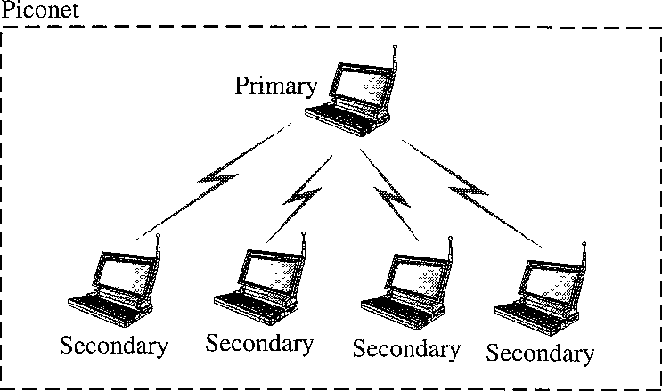
Piconet
Although a piconet can have a maximum of seven secondaries, an additional eight secondaries can be in the parked state.
A secondary in a parked state is synchronized with the primary, but cannot take part in communication until it is moved from the parked state.

Slide 64
Piconet
Because only eight stations can be active in a piconet, activating a station from the parked state means that an active station must go to the parked state.

Slide 65
Scatternet
Piconets can be combined to form what is called a scatternet.
A secondary station in one piconet can be the primary in another piconet. This station can receive messages from the primary in the first piconet (as a secondary) and, acting as a primary, deliver them to secondaries in the second piconet.
A station can be a member of two piconets.

Slide 66
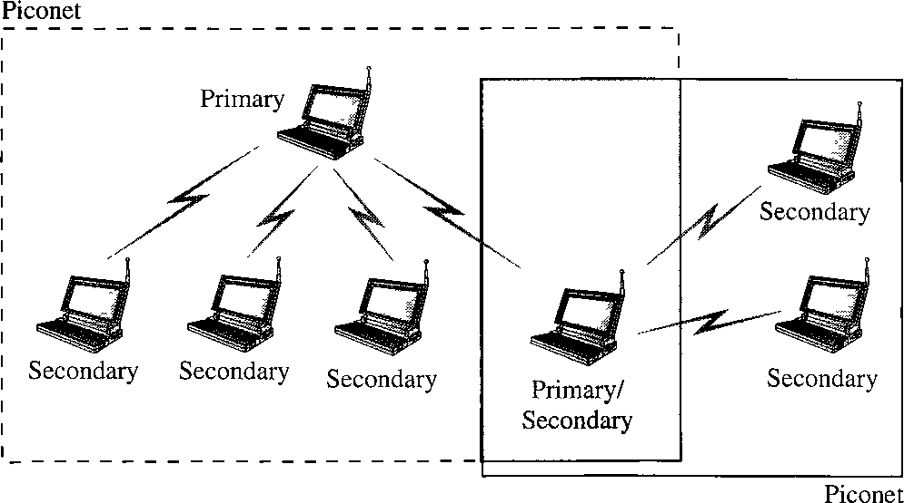
Bluetooth Devices
A Bluetooth device has a built-in short-range radio transmitter. The current data rate is 1 Mbps with a 2.4- GHz bandwidth. This means that there is a possibility of interference between the IEEE 802.11b wireless LANs and Bluetooth LANs.

Slide 67
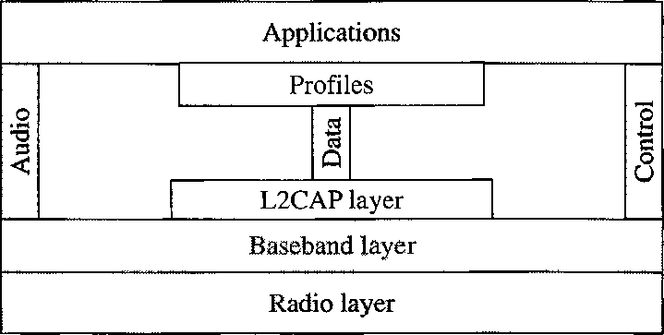
Bluetooth Layers
– Bluetooth uses several layers that do not exactly match those of the Internet models

Slide 68
Radio Layer
The radio layer is roughly equivalent to the physical layer of the Internet model.
Bluetooth devices are low-power and have a range of 10 m.
Band
Bluetooth uses a 2.4-GHz ISM band divided into 79 channels of 1 MHz each.

Slide 69
FHSS
Bluetooth uses the frequency-hopping spread spectrum (FHSS) method in the physical layer to avoid interference from other devices or other networks.
Bluetooth hops 1600 times per second, which means that each device changes its modulation frequency 1600 times per second.
A device uses a frequency for only 625 us (1/1600 s) before it hops to another frequency; the dwell time is 625 us.

Slide 70
Modulation
– To transform bits to a
signal, Bluetooth uses a
sophisticated version of PSK, called GPSK (PSK with Gaussian bandwidth filtering; GPSK has a carrier frequency.
Bit 1 is represented by a frequency deviation above the carrier; bit 0 is represented by a frequency deviation below the carrier.
The frequencies, in megahertz, are defined using the formula for each channel:
fc=2402+n where n =0,1,2,3, ...,78

Slide 71
Baseband Layer
The baseband layer is roughly equivalent to the MAC sublayer in LANs.
The access method is TDMA.
The primary and secondary communicate with each other using time slots.
The length of a time slot is exactly the same as the dwell time, 625 us.
This means that during the time that one frequency is used, a sender sends a frame to a secondary, or a secondary sends a frame to the primary.
Note that the communication is only between the primary and a secondary; secondaries cannot communicate directly with one another.

Slide 72
Baseband Layer
TDMA
Bluetooth uses a form of TDMA that is called TDD-TDMA (time division duplex TDMA).
TDD-TDMA is a kind of half-duplex communication in which the secondary and receiver send and receive data, but not at the same time (halfduplex)
however, the communication for each direction uses different hops.
Single-Secondary Communication If the piconet has only one secondary, the TDMA operation is very simple.
The time is divided into slots of 625 us, The primary uses even numbered slots (0, 2, 4, ...); the secondary uses odd-numbered slots (I, 3, 5, ...).
TDD-TDMA allows the primary and the secondary to communicate in half-duplex mode.

Slide 73
Baseband Layer
Single-secondary communication

Slide 74
Baseband Layer
Multiple-Secondary Communication
The process is a little more involved if there is more than one secondary in the piconet.
Again, the primary uses the even-numbered slots, but a secondary sends in the next odd-numbered slot if the packet in the previous slot was addressed to it.
All secondaries listen on even-numbered slots, but only one secondary sends in any odd-numbered slot.

Slide 75
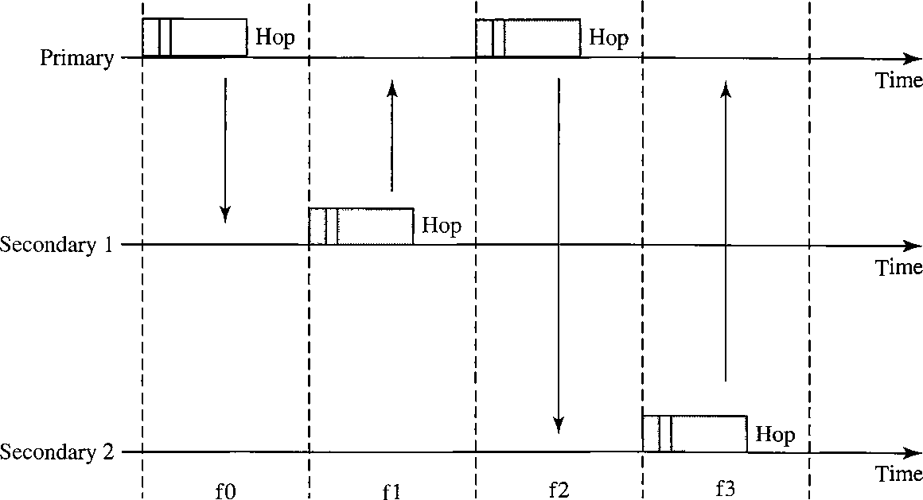
Multiple-Secondary Communication

Slide 76
Multiple-Secondary Communication
We can say that this access method is similar to a poll/select operation with reservations.
When the primary selects a secondary, it also polls it. The next time slot is reserved for the polled station to send its frame. If the polled secondary has no frame to send, the channel is silent.

Slide 77
Physical Links
Two types of links between a primary and a secondary:
SCO A synchronous connection-oriented (SCO)
link is used when avoiding latency (delay in data delivery) is more important than integrity (error-free delivery).
a physical link is created between the primary and a secondary by reserving specific slots at regular intervals.
The basic unit of connection is two slots, one for each direction. If a packet is damaged, it is never retransmitted.
sco is used for real-time audio where avoiding delay is all-important.
A secondary can create up to three sco links with the primary, sending digitized audio (PCM) at 64 kbps in each link.

Slide 78
Physical Links
ACL An asynchronous connectionless link (ACL)
is used when data integrity is more important than
avoiding latency. In this type
of link, if a payload is corrupted, it is
encapsulated in the frame retransmitted.
A secondary returns an ACL frame in the available odd-numbered slot if and only if the previous slot has been addressed to it.
ACL can use one, three, or more slots and can achieve a maximum data rate of 721 kbps.

Slide 79
Frame Format
A frame in the baseband layer can be one of three types: one-slot, three-slot, or five-slot.
A slot is 625 us. However, in a one-slot frame exchange, 259 us is needed for hopping and control mechanisms. This means that a one-slot frame can last only 625 - 259, or 366 us. With a 1-MHz bandwidth and 1 bit/Hz, the size of a one-slot frame is 366 bits.
A three-slot frame occupies three slots. However, since 259 us is used for hopping, the length of the frame is 3 x 625 - 259 = 1616 us or 1616 bits.
A device that uses a three-slot frame remains at the same hop (at the same carrier frequency) for three slots.
Even though only one hop number is used, three hop numbers are consumed. That means the hop number for each frame is equal to the first slot of the frame.
A five-slot frame also uses 259 bits for hopping, which means that the length of the frame is 5 x 625 - 259 = 2866 bits.

Slide 80
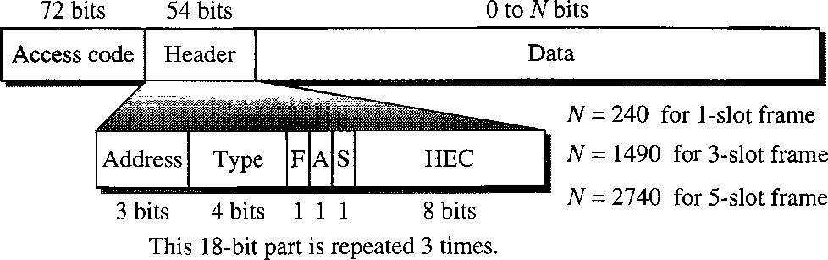
Frame Format
Access code
This 72-bit field normally contains synchronization bits and the identifier of the primary to distinguish the frame of one piconet from another.

Slide 81
Frame Format
Header. This 54-bit field is a repeated I8-bit pattern.
Address. Can define up to seven secondaries (1 to 7).
If the address is zero, it is used for broadcast communication from the primary to all secondaries.
Type. The 4-bit type subfield defines the type of data coming from the upper layers.
F. This 1-bit subfield is for flow control. When set (1), it indicates that the device is unable to receive more frames (buffer is full).
A. This 1-bit subfield is for acknowledgment. Bluetooth uses Stop-and-Wait ARQ; 1 bit is sufficient for acknowledgment.
S. This 1-bit subfield holds a sequence number. Bluetooth uses Stop-and-Wait ARQ
HEC. The 8-bit header error correction subfield is a checksum to detect errors in each 18-bit header section.

Slide 82
Frame Format
The header has three identical 18-bit sections. The receiver compares these three sections, bit by bit.
If each of the corresponding bits is the same, the bit is accepted;
if not, the majority opinion rules. This is a form of forward error correction (for the header only).
This double error control is needed because the nature of the communication, via air, is very noisy.
Note that there is no retransmission in this sublayer

Slide 83
Frame Format
Payload. This subfield can be 0 to 2740 bits long. It contains data or control information coming from the upper layers.

Slide 84
L2CAP
The Logical Link Control and Adaptation Protocol, or L2CAP (L2 here means LL), is roughly equivalent to the LLC sublayer in LANs.
It is used for data exchange on an ACL link; SCO channels do not use L2CAP.
The I6-bit length field defines the size of the data, in bytes, coming from the upper layers.
Data can be up to 65,535 bytes.
The channel id (CID) defines a unique identifier for the virtual channel created at this level.
The L2CAP has specific duties: multiplexing, segmentation and reassembly, quality of service (QoS), and group management.

Slide 85
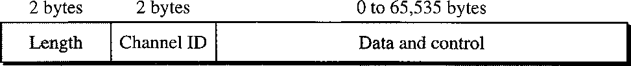
Multiplexing
The L2CAP can do multiplexing.
At the sender site, it accepts data from one of the upper-layer protocols, frames them, and delivers them to the baseband layer.
At the receiver site, it accepts a frame from the baseband layer, extracts the data, and delivers them to the appropriate protocol layer.
It creates a kind of virtual channel

Slide 86
Segmentation and Reassembly
The maximum size of the payload field in the baseband layer is 2774 bits, or 343 bytes.
This includes 4 bytes to define the packet and packet length. Therefore, the size of the packet that can arrive from an upper layer can only be 339 bytes. However, application layers sometimes need to send a data packet that can be up to 65,535 bytes (an Internet packet, for example).
The L2CAP divides these large packets into segments and adds extra information to define the location of the segments in the original packet.
The L2CAP segments the packet at the source and reassembles them at the destination.

Slide 87
QoS
Bluetooth allows the stations to define a quality-of-service level.
it is sufficient to know that if no quality-of-service level is defined, Bluetooth defaults to what is called best-effort service; it will do its best under the circumstances.
Group Management
Another functionality of L2CAP is to allow devices to create a type of logical addressing between themselves. This is similar to multicasting.
For example, two or three secondary devices can be part of a multicast group to receive data from the primary.

Slide 88
Reference
Data and computer communications by William Stallings, Pearson.

